Slide 1

9.3 Matching Problem
Definition 9.14 Given an undirected graph G = (V, E), a matching is a subset of edges M E such that for all vertices v∈V, at most one edge of M is incident on v. We say that a vertex v ∈V is matched by matching M if some edge in M is incident on v; otherwise, v is unmatched. A maximum matching is a matching of maximum cardinality.
Definition 9.15 Perfect matching is one in which every vertex in V is matched
Maximum weight matching:Matching in a weighted graph in which the sum of the weights of its edges is maximum.

Slide 2
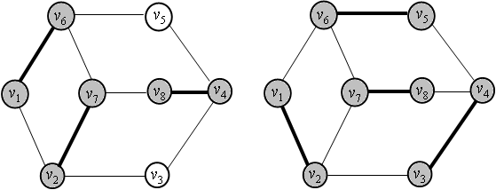
Alternating path: Alternating between matching and non-matching edges.
Augmenting path: A nontrivial alternating path that begins and ends with unmatched vertices.
Alternating cycle: if the two endpoints of an augmenting path coincide

Slide 3
Definition 9.17 Let M₁ and M₁ be two matchings in a graph G, define
Lemma 9.6 Suppose M is a matching and P is an augmenting path, Then M ⊕ P is also a matching, and |M ⊕ P | = |M| + 1
Theorem 9.9 A matching is maximum if and only if there is no augmenting path.

Slide 4

Max matching algorithm
MaximumMatching(G)
1 M←0
2 repeat
3 find an augmenting path p
4
5 until no augmenting path in G
6 return M

Slide 5
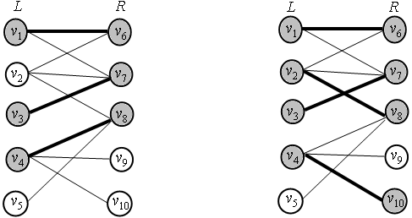
Bipartite Graph
Graph G = ( L ∪ R, E) with L ∩ R = ∅, namely
A graph is bipartite if its vertex set can be partitioned into two subsets L and R so that each edge has one endpoint in L and the other endpoint in R.

Slide 6
Intuition
Let the left set of vertices be men
Let the right set of vertices be women
Suppose each edge represents a pair of man and woman who like each other
Maximum matching tries to maximize the number of couples!

Slide 7
Applications
Matching has many applications:
  Task assignment problems.
  Measuring data similarity.
  Relationship to network flow.
  Subroutine in many other algorithms.

Slide 8
Algorithms for this problem
The max flow algorithm
We define the corresponding flow network G' = (V', E') for the bipartite graph G as follows. We let the source s and sink t be new vertices not in V, and we let V' = V∪{s, t}. If the vertex partition
of G is V = L∪ R, the directed edges of G' are the edges of E, directed from L to R, along with V new edges:
E' = {(s, u) : u∈L}
∪{(u, v) : u∈L, v∈R, and (u, v)∈E}
∪{(v, t) : v∈R}.

Slide 9
Theorem 9.11 Let G = (V, E) be a bipartite graph with vertex partition V = L∪R, and let G' = (V', E') be its corresponding flow network. If M is a matching in G, then there is an integer-valued flow f in G' with value |f | = |M|. Conversely, if f is an integer-valued flow in G', then there is a matching M in G with cardinality |M| = |f|.

Slide 10
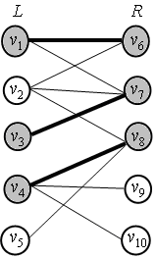
Hungarian tree Algorithm
Alternating Path
Alternating between matching and non-matching edges.
v1-v6-v2: alternating path
v2-v8-v4-v10: alternating path starts and ends with free vertices, it is a augmenting path

Slide 11
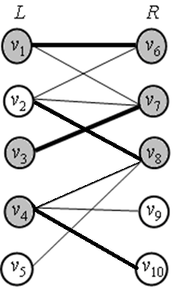
Idea(Hungarian tree Algorithm)
“Flip” augmenting path to get better matching
Note: After
flipping, the number of matched edges will increase by 1!
→

Slide 12
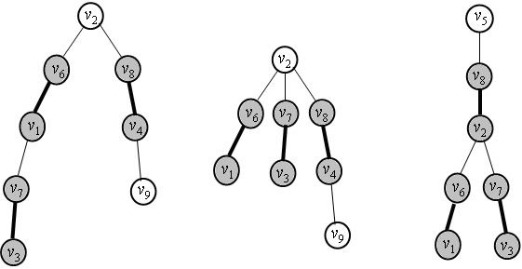
Hungarian tree Algorithm
Finding a augmenting path from an
unmatched vertex
DFS and BFS

Slide 13


Hungarian tree Algorithm
HungryBipartiteGraph(G)
1 begin with any matching M
2 while there exists an unmatched vertex in L and R respectively do
3 let r is an unmatched vertex in L
4 grow an alternating path tree T with root r using breadth first search
5 if T is a Hungarian tree then
6
7 else
8 find an augmenting path p in T
9
10 return M

Slide 14
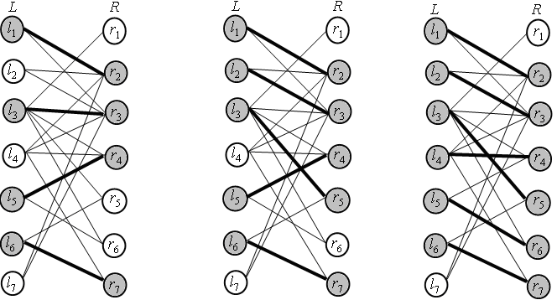
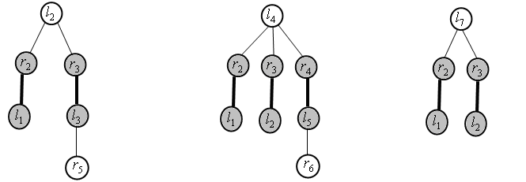

Slide 15
We can find at most |V| augmenting paths (why?)
To find an augmenting path, we use bfs! Time required = O( |V| + |E| )
Total time: O(|V|² + |V| |E|)

Slide 16
Weighted bipartite matching
Unweighted case: maximize the number of edges in matching
Weighted case: maximize the sum of the weights in the matching
Solvable in polynomial time using similar concepts.

Slide 17
Stable matchings
Instead of weights we are given preference rankings
In other words, each node ranks available nodes
Suppose we have matched pairs
(x, b) and (y, a) but
  x prefers a to b and
  a prefers x to y
We say the unmatched pair (x,a) is unstable.
A stable matching is a matching with no unstable unmatched pair.
Solvable in polynomial time.

Slide 18

Online weighted bipartite matching
Your ad here
2PM,
$2
$2
Your
ad
here
$2
$3
4PM,
$3
$3
Ur
ad
hr
arrives
makes a bid
Bidder
Bids for slots arrive sequentially
  Decision must be taken online
Goal: efficient allocation (matching)
Seller denies/awards reservation

Slide 19
Homework
Page 174 9.19
Implement HungryBipartiteGraph(G)

